Slide 1
The Role of Drug and Alcohol Providers in the Elimination of
HIV/Viral Hepatitis in Pennsylvania
State Opioid Response Grant Funding
Pennsylvania Department of Health
Notes:
LO

Slide 2
Presentation Objectives
Discuss the background and significance of this initiative
Identify the goals of the project
Consider the collaborative role the Single County Authorities (SCA) and Licensed Drug and Alcohol Providers have in the Elimination of HIV/Viral Hepatitis for Pennsylvanians

Slide 3




Key Speakers
Dr. Lauren Orkis, DrPH PA Department of Health, Bureau of Epidemiology, Project Lead & Viral Hepatitis Prevention Coordinator
Jeremy Sandberg, Penn State
Educational Psychology, Counseling, & Special Education
Stacey B. Trooskin, MD, PhD, Philadelphia FIGHT
Chief Medical Officer
C-Change, Program Director
E. Renea Snyder, MS, MAC, Psychotraumatologist,
PA DOH, Project Manager, Bureau of Epidemiology

Slide 4

SUD, HIV and Hepatitis Syndemic
Coincidence of HCV Infections and Opioid Injection
Injection drug use is a major driver of HIV and Viral Hepatitis infections
Sharing of injection equipment
Sexual & injecting networks
Homelessness
30
2.5
Any opioid injection (ages 18-29 yrs)
Any opioid injection (ages 30-39 yrs)
Acute HCV (ages 18-29 yrs)
Acute HCV (ages 30-39 yrs)
25
2.0
20
% Drug Treatment Admissions Reporting Injection of Any Opioid
1.5
15
Acute HCV Incidence
1.0
10
5
0.5
0
0
2004
2006
2008
2010
2012
2014
Slide credit: clinicaloptions.com
CDC. https://www.cdc.gov/nchhstp/newsroom/2017/hepatitis-c-and-opioid-injection-press-release.html.
Notes:
mention smoking and snorting too

Slide 5
Essential Role of Drug & Alcohol Providers
Licensed Drug and Alcohol Treatment providers engage patients/clients with Substance Use Disorder at high risk for HIV/Viral Hepatitis
Providers have a vital opportunity to offer interventions that can have a profound impact on a patient’s/client’s health & wellbeing, prevention/intervention, and the public’s health
Notes:
LO
Emphasize “meeting people where they’re at” by bringing services to the patient in the setting they’re already engaged in
Opportunity to talk up the key role SUD tx providers play, their leadership

Slide 6
HIV:
Challenges & Opportunities
Notes:
JS

Slide 7
What is HIV?
HIV is a virus that attacks the body’s immune system
If left untreated, HIV is progressive and leads to increased vulnerability to serious illness and death
With treatment, HIV is a manageable chronic illness

Slide 8
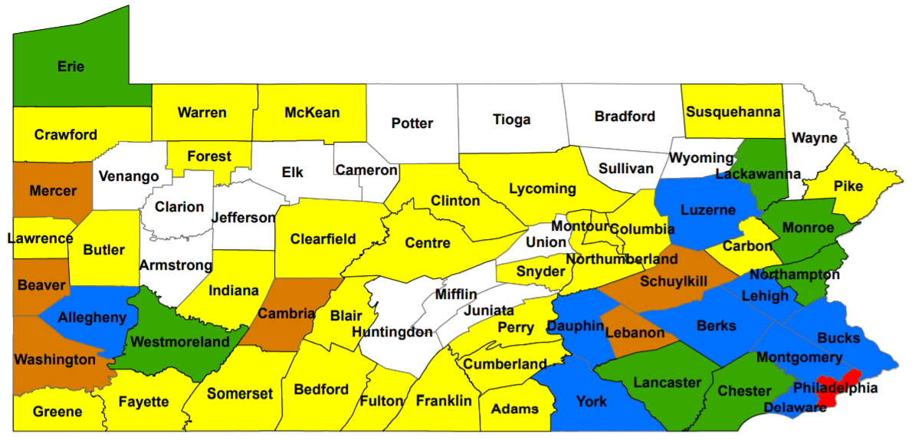
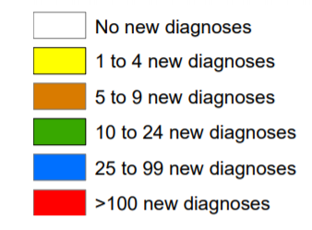
New Diagnoses of HIV by County, 2019
Notes:
Quick, local visual. Emphasize proportion of folks whose risk is IDU.
Jeremy’s stats:
In 2019
There were 986 individuals newly diagnosed with HIV infections in Pa. Of those individuals, 131 or 13% reported injecting drugs as a risk
There were 35,949 people presumed to be living with HIV (PLWH) in Pa. Approximately 22% of individuals living with HIV reported injecting drugs as a risk

Slide 9
IDU & HIV: A looming crisis
Indiana
West Virginia
The site of a severe HIV outbreak among people who inject drugs (PWID) from 2011-2014
215 HIV infections
92 percent with HCV coinfections
As recently as 2014, only 12.5 percent of HIV cases in WV were from injection drug use (IDU)+
By 2019, 64.2 percent of HIV cases were from IDU
Notes:
Can mention these status to illustrate the severity:
In Kanawha County (pop. 178k)
2018 = 2 IDU cases
2019 = 15 IDU cases
2020 = at least 35 IDU cases
In New York City (pop. 8M) 2020 = 36 IDU cases

Slide 10
HIV Testing
CDC Recommendations for HIV Screening
HIV screening is recommended for patients/clients in all health-care settings after the patient/client is notified that testing will be performed unless the patient/client declines (opt-out screening).
Persons at high risk for HIV infection should be screened for HIV at least annually.
Separate written consent for HIV testing should not be required; general consent for medical care should be considered sufficient to encompass consent for HIV testing.
Prevention counseling should not be required with HIV diagnostic testing or as part of HIV screening programs in health-care settings.
https://www.cdc.gov/mmwr/preview/mmwrhtml/rr5514a1.htm
Notes:
CDC & US Prevention Task Force both recommend routine, opt out screening for HIV as a part of regular healthcare provision - we no longer need to treat HIV as a special condition.
Routinizing decreases stigma, increases dx and linkage to tx, resulting in better outcomes for the patient and the public’s health

Slide 11
HIV FACTS
HIV is a chronic, but manageable condition
For most people, HIV treatment means taking one pill, once a day
When treated, People Living with HIV (PLWH) can live long, healthy lives
HIV treatment reduces HIV virus in the blood to “undetectable levels”, though some virus remains in the body

Slide 12

Preventing HIV
We have a robust toolbox for preventing HIV
Pre-exposure Prophylaxis (PrEP)
  One pill once a day prevents HIV
Treatment as prevention
  Undetectable = Untransmittable!
Notes:
MR
Refer back to testing - test → dx → treat → tasp
test → id risk → prep

Slide 13
Hepatitis C Virus (HCV):
Challenges & Opportunities
Notes:
LO

Slide 14
What is Hepatitis C?
Hepatitis C is a contagious liver disease caused by the Hepatitis C virus (HCV)
Transmission of HCV is primarily through contact with the blood of an infected person
  Injection drug use with sharing of infected equipment
  Sex
  Vertical transmission during childbirth
HCV CAN BE CURED

Slide 15



Epidemics Intertwined
HCV antibody prevalence among people who inject drugs (PWID) is estimated to be 70 percent to 77 percent
45%
to
85%
1 of 3 people who inject drugs acquires HCV infection in their first year of injecting²
45 percent to 85 percent of individuals chronically infected with HCV are unaware of their status¹
HCV is the most common
chronic blood-borne infection in the US
CDC. Surveillance of Viral Hepatitis—United States, 2015. https://www.cdc.gov/hepatitis/statistics/2015surveillance/pdfs/2015HepSurveillanceRpt.pdf. Accessed August 2, 2018; 2. Hagan H, et al. Am J Epidemiol. 2008;168(10):1099-1109.

Slide 16
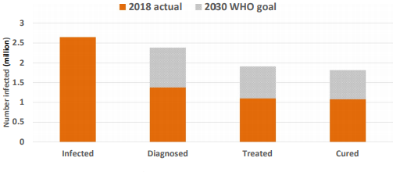
US HCV Treatment Cascade
Thomas, D. CID, 16,1. July 2020
Thomas, D. CID, 16,1. July 2020
Notes:
This is the cascade, we have a lot of work to do but also have the tools and knowledge to achieve elimination (that’s why we’re here to offer this service!)
Quickly point to places where SUD tx providers can impact the cascade

Slide 17
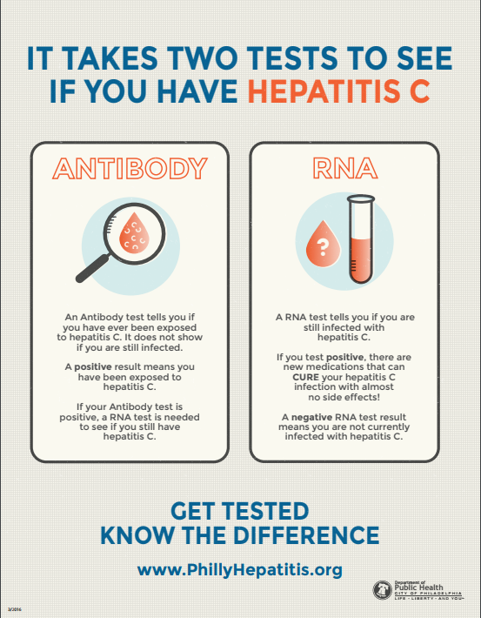
Key Messages: HCV Testing
Initial Testing for HCV Antibody
Testing for HCV Ribonucleic acid (RNA)
HCV testing and referral models can be integrated into behavioral health settings

Slide 18
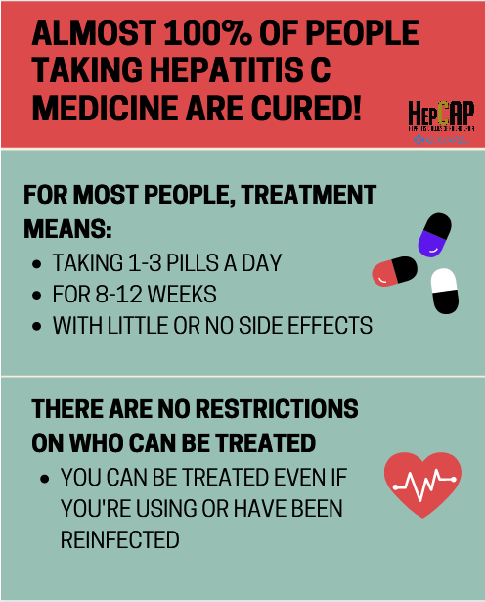
Key Messages: HCV treatment
Treatment is recommended for all patients/clients with chronic HCV infection.
Active drug use or Medication-Assisted Treatment (MAT) should not be reasons to deny treatment to someone

Slide 19
HCV Treatment is Accessible
Changes to Pennsylvania Medicaid Direct-acting Antiviral Restrictions
2014 | 2015/2016 | 2017 | 2018
Fibrosis Score (F)3/F4 No exception for HIV patients/clients No drugs or alcohol for 6 months Specialist physician | F2 for HCV monoinfected patients/clients F0 for HIV/HCV coinfection, or anyone with extrahepatic manifestation No sobriety requirement Specialist provider | F1 for HCV monoinfected patients/clients (July 1, 2017) | F0 for HCV monoinfected patients/clients (January 1, 2018) Expanded to include PCPs who treat in consultation with a specialist; or, who are experienced in HCV management (January 1, 2018)
Center for Health Law and Policy Innovation of Harvard Law School (CHLPI) and National Viral Hepatitis Roundtable (NVHR). 2017. https://stateofhepc.org/. Accessed August 2, 2018.

Slide 20
PA DOH/DDAP Pilot Hep C Survey
Statewide random selection of 330 Licensed Drug and Alcohol facilities
Surveyed facilities to determine Hepatitis C services and barriers
Survey conducted in 2019
  Response rate = 77 percent
Follow-up survey conducted in 2020
  Response rate = 56 percent
Notes:
We determined through follow up that 14 facilities were not able to complete the electronic survey but of those 316 eligible, 76% completed the survey. We did some follow up with facilities by phone if the electronic survey was not completing which improved the response rate.

Slide 21
Only 32% test all clients for HCV
76 (32)
test all clients
Source: DOH/DDAP HCV Survey 2019
Notes:
Through this survey, we focused on hepatitis C-related services but also asked about hepatitis A, B and other infectious disease services. In total, only 32% of facilities surveyed said that they test all their clients at least once for hepatitis C and the type of testing varied quite a bit.

Slide 22
Barriers to Hepatitis C Testing
Funding
No Barriers
Staff Time
Client Buy-in
Medicaid Reimbursement Issues
Private Reimbursement Issues
Behavioral Health Payer Issues
Stigma
Source: DOH/DDAP HCV Survey 2019
Staff Buy-in
n=230
Notes:
Facilities reported many barriers to offering hepatitis C testing including funding at almost 30% of facilities. Surprisingly, 26% of facilities reported no barriers so we will be following up with these facilities this summer to solicit best practices from these facilities. 17% of facilities reported reimbursement issues which we will also be investigating further.

Slide 23
Other Infectious Disease Services
Source: DOH/DDAP HCV Survey 2019

Slide 24

How can we work together?
Funding
No Barriers
Staff Time
Client Buy-in
Medicaid Reimbursement Issues
Private Reimbursement Issues
Behavioral Health Payer Issues
Stigma
Notes:
Facilities reported many barriers to offering hepatitis C testing including funding at almost 30% of facilities. Surprisingly, 26% of facilities reported no barriers so we will be following up with these facilities this summer to solicit best practices from these facilities. 17% of facilities reported reimbursement issues which we will also be investigating further.

Slide 25

Funding
TOGETHER
We Can Eliminate
HIV and Viral Hepatitis!
No Barriers
Staff Time
Client Buy-in
Medicaid Reimbursement Issues
Private Reimbursement Issues
Behavioral Health Payer Issues
Stigma
Notes:
Facilities reported many barriers to offering hepatitis C testing including funding at almost 30% of facilities. Surprisingly, 26% of facilities reported no barriers so we will be following up with these facilities this summer to solicit best practices from these facilities. 17% of facilities reported reimbursement issues which we will also be investigating further.

Slide 26

Project Goals to Assist Providers
Funding
Provide HIV/Viral Hepatitis education and resources for patients/clients
Clinical education
Increase screening
Increase access to treatment
Align policies with national guidelines
Identify and address barriers to HIV/Viral Hepatitis services
No Barriers
Staff Time
Client Buy-in
Medicaid Reimbursement Issues
Private Reimbursement Issues
Behavioral Health Payer Issues
Stigma
Notes:
Facilities reported many barriers to offering hepatitis C testing including funding at almost 30% of facilities. Surprisingly, 26% of facilities reported no barriers so we will be following up with these facilities this summer to solicit best practices from these facilities. 17% of facilities reported reimbursement issues which we will also be investigating further.

Slide 27

Project Goals to Assist Providers
Funding
Provide onsite capacity assessments
Develop individualized protocols based on facility’s goals
Educate/assist with billing capabilities for services
Increase program capacity to offer services onsite
No Barriers
Staff Time
Client Buy-in
Medicaid Reimbursement Issues
Private Reimbursement Issues
Behavioral Health Payer Issues
Notes:
Facilities reported many barriers to offering hepatitis C testing including funding at almost 30% of facilities. Surprisingly, 26% of facilities reported no barriers so we will be following up with these facilities this summer to solicit best practices from these facilities. 17% of facilities reported reimbursement issues which we will also be investigating further.

Slide 28
Next Steps
SCAs will receive an email after the Pennsylvania Association of County Drug and Alcohol Administrators (PACDAA) meeting
Each SCA will receive an individualized welcome packet
  Sample resources
  County specific data
  Contact for initial meeting
Funding
No Barriers
Staff Time
Client Buy-in
Medicaid Reimbursement Issues
Private Reimbursement Issues
Behavioral Health Payer Issues
Stigma
Notes:
Facilities reported many barriers to offering hepatitis C testing including funding at almost 30% of facilities. Surprisingly, 26% of facilities reported no barriers so we will be following up with these facilities this summer to solicit best practices from these facilities. 17% of facilities reported reimbursement issues which we will also be investigating further.

Slide 29
Funding
DOH Project Manager
E. Renea Snyder
c-emsnyder@pa.gov
717-982-0955
Staff Time
Client Buy-in
Medicaid Reimbursement Issues
Private Reimbursement Issues
Behavioral Health Payer Issues
*DRAFT – Please do not distribute
Notes:
Facilities reported many barriers to offering hepatitis C testing including funding at almost 30% of facilities. Surprisingly, 26% of facilities reported no barriers so we will be following up with these facilities this summer to solicit best practices from these facilities. 17% of facilities reported reimbursement issues which we will also be investigating further.

